Slide 1
Motorcycle Pricing System
Cloud Computing 2021/2022 – final project
Amir Ali & Stanisław Matuszewski & Mateusz Kierznowski

Slide 2
Functional requirements & Use cases
Scrapping motorcycle data
Dumping Data into a DynamoDB instance.
Working web app with possibility to quotation
Creating a well-performing model with a connection to Webapp
Preparing log from scrapping

Slide 3
Non-functional requirements
Each request should be processed within 15 seconds
The system is scalable and Cost-effectiveness
Ensure high availability of the Motorbike dataset
The System is easy to use - i.e. user is just required to type and click then the result is displayed
Implement DR scenarios for the system ensuring RPO at a level of 6 hours

Slide 4
Technologies and Libraries
Backend part
Scrapper part
Model part
boto3
Beautiful Soup
Pandas
Sagemaker
NumPy
Tensorflow
Scikit-learn
Pickle

Slide 5
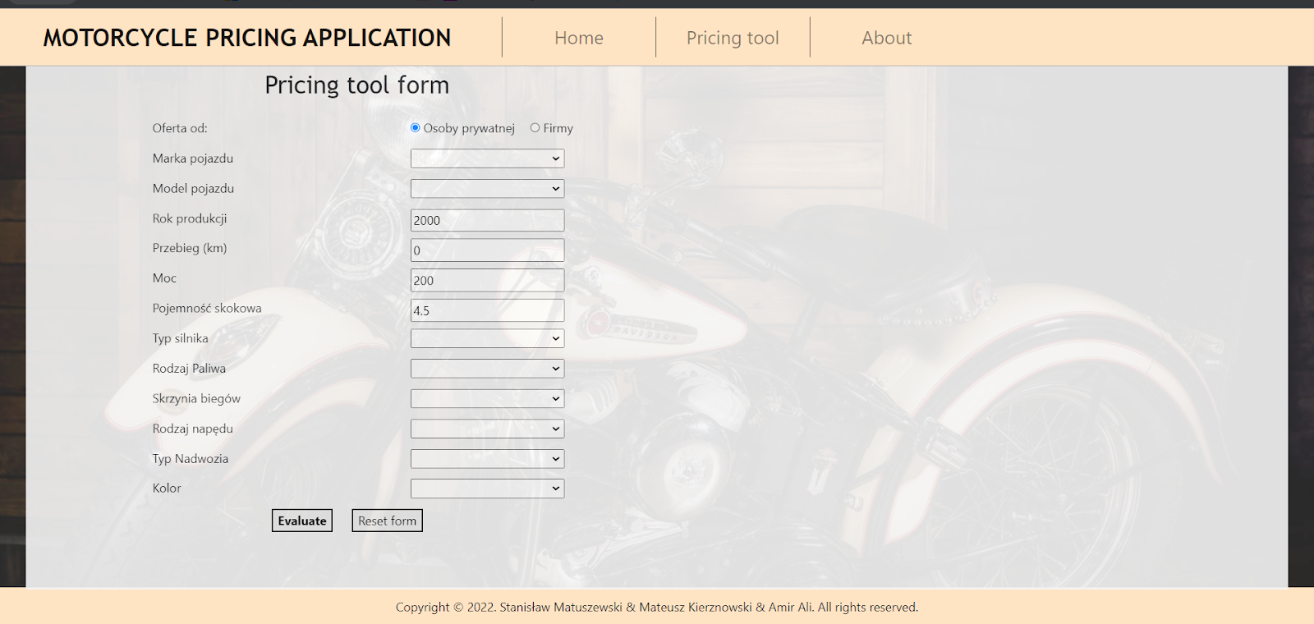
Web application – User Interface

Slide 6
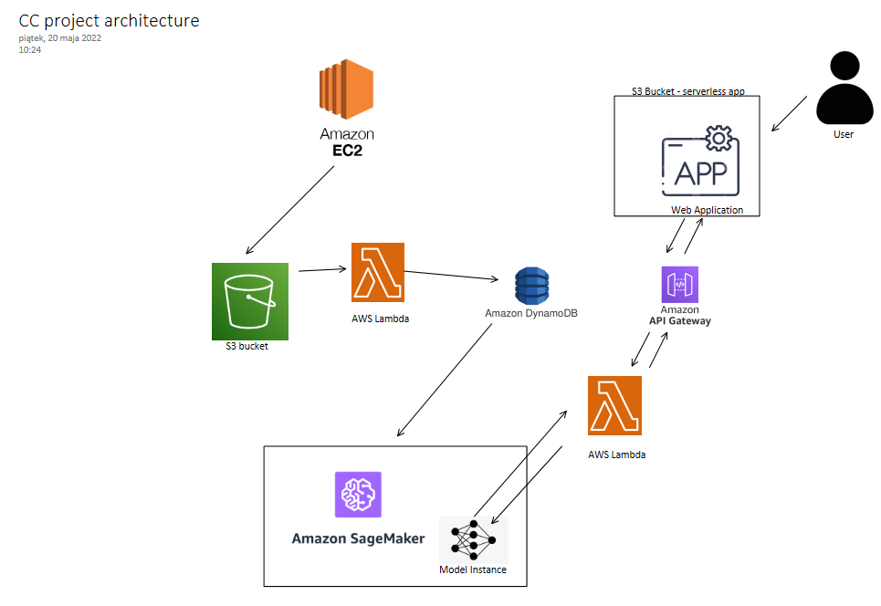

Slide 7
Thank you!
Any more specific questions?

